Slide 1
Picture and Context of TK
Regenerative Carbon Ranching at
TomKat Ranch
Notes:
1- regenerative ranching and farming leverage healthy carbon cycles to grow food, fuel and fiber while also increasing productivity and resiliency of the land and fostering a stable climate, healthy watersheds, and thriving communities.
2- carbon farm/ranch plans are an empowering, accessible, and PERSONALIZED way for ranchers and farmers to access this information and add new tools to their toolbox that help them reach their short and long term ranch/farm goals.
3- RCDs are the perfect partners for helping to share these tools with ranchers and farmers. The trust and expertise they have cultivated in their communities are the best chance there is for engaging even climate-change skeptics on the benefits of carbon farming.

Slide 2
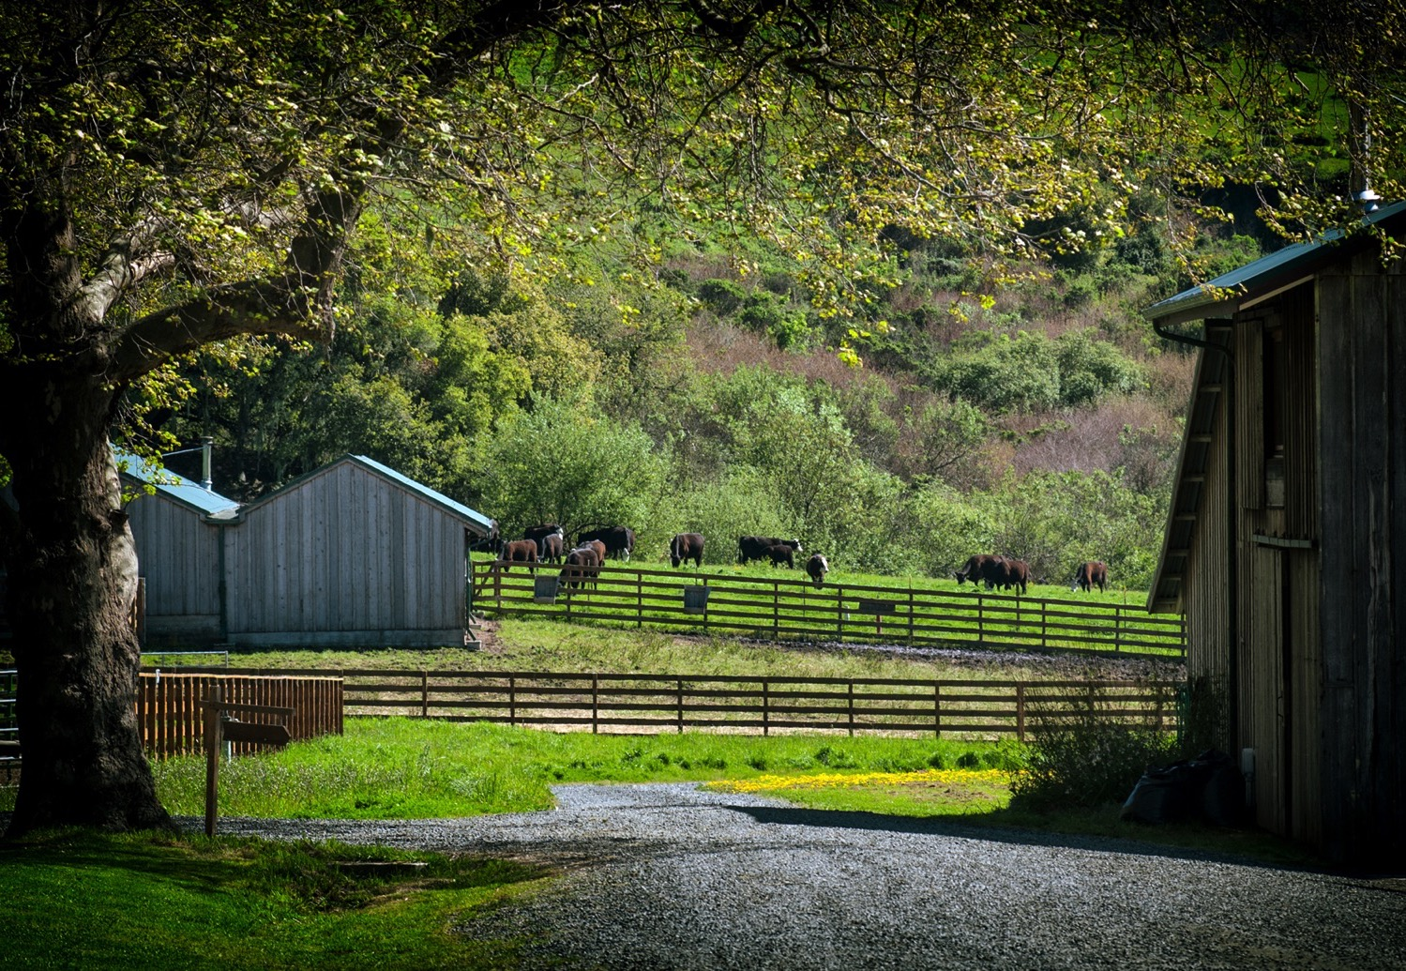
Regenerative Ranching | Education and Outreach | Food for Good
TomKat Ranch works to discover and share the demonstrable benefits of regenerative rangeland management and create or support the tools and conditions that speed its adoption. | TomKat Ranch hosts and participates in diverse and innovative conversations about the regenerative food system. It strives to be an empirical, collaborative, and catalyzing voice for its target audiences, the next generation, key thought leaders, and the public. | The Ranch works in coalition with its partners to grow robust demand for grass-fed products as well as help foster a scaled regenerative food system.
Notes:
Regenerative agriculture is a method of farming that aims to restore the fertility of the soil and the overall health of the land it’s conducted on, limiting the use of synthetic inputs like pesticides and fertilizers and limiting tillage of the soil.

Slide 3
More Photosynthesis
More Soil Organic Matter
More Water Holding Capacity
We can grow food, fuel, and fiber while improving the productivity and resiliency of our land.

Slide 4
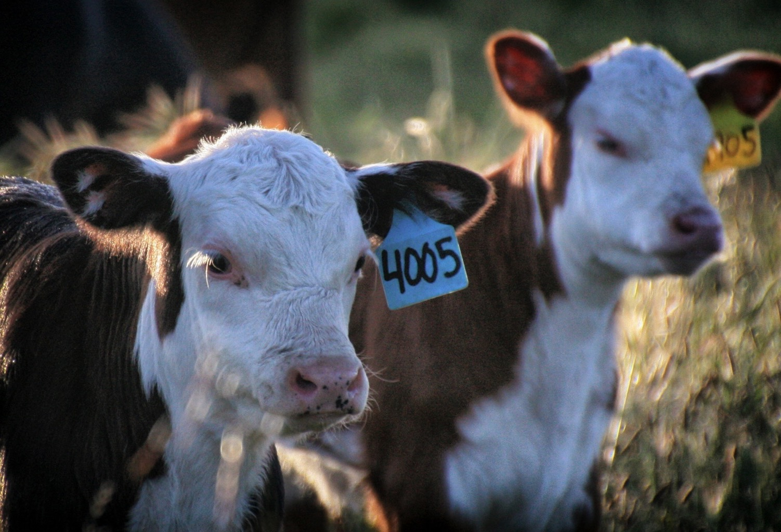
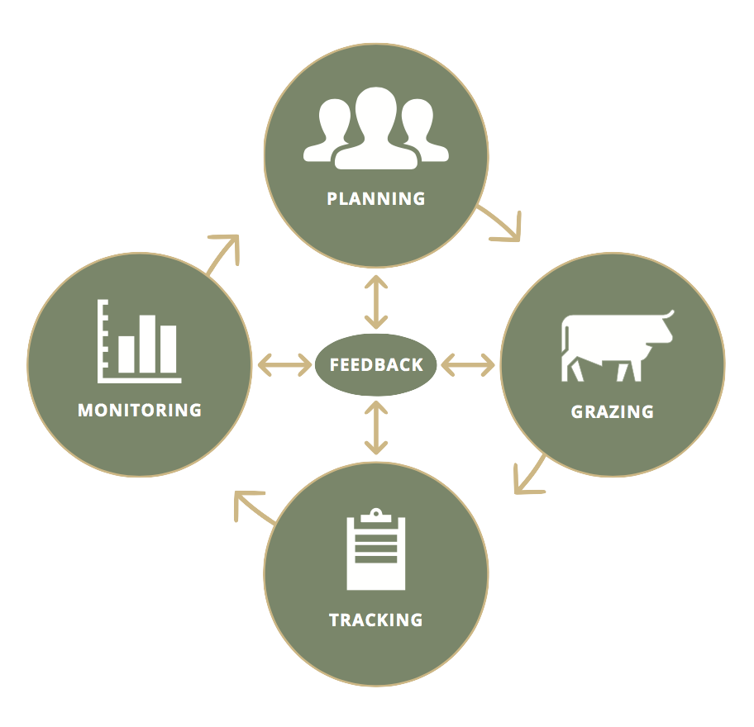
Regenerative Ranching is Learning from Feedback
Notes:
Planning: grazing plan, strategic plan, conservation plan, and carbon plan- integrating those.
Monitoring: are part of point blue’s rangeland monitoring network. Measuring soil, tracking birds.

Slide 5
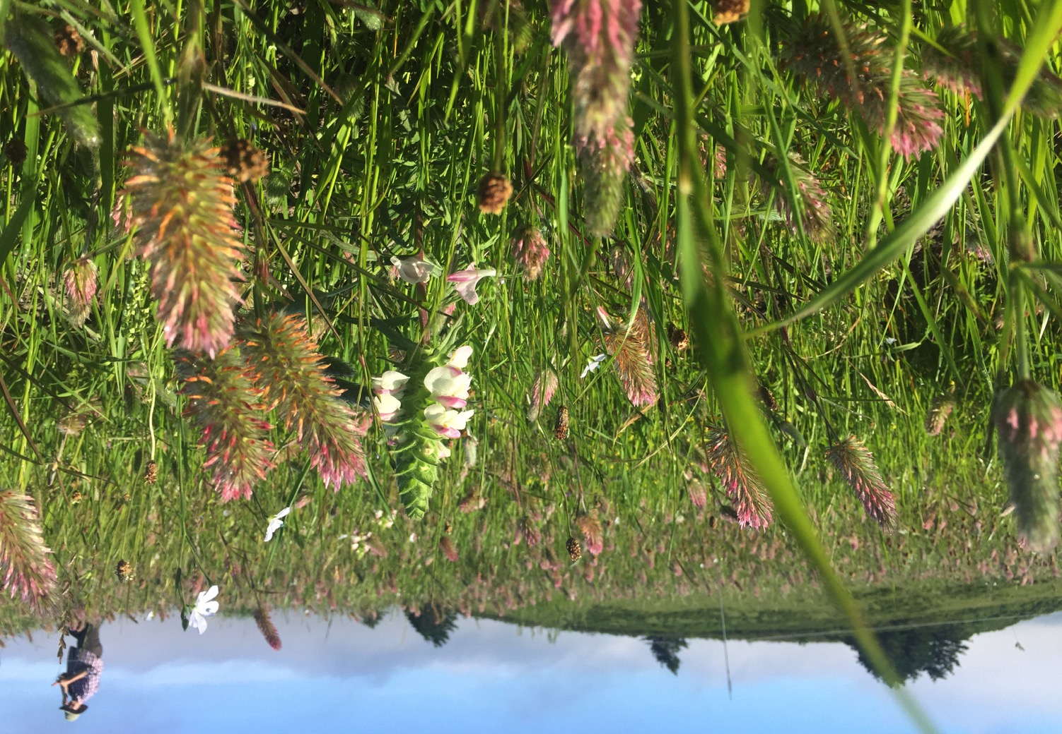
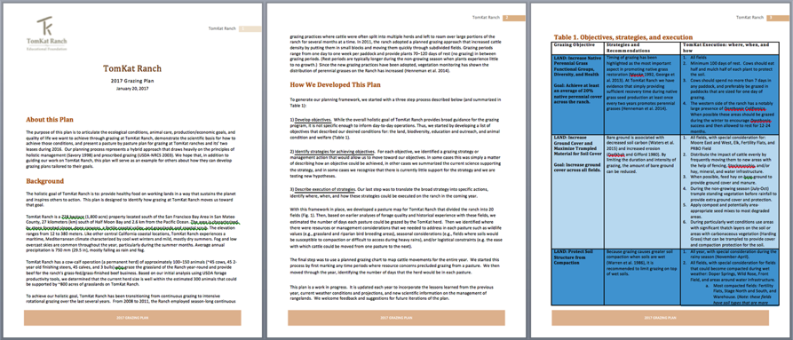
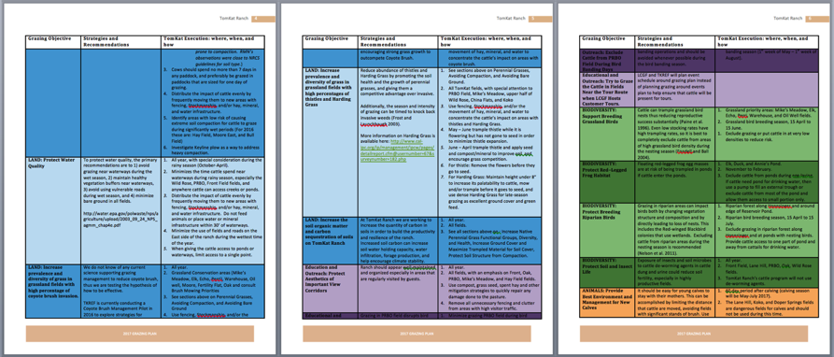
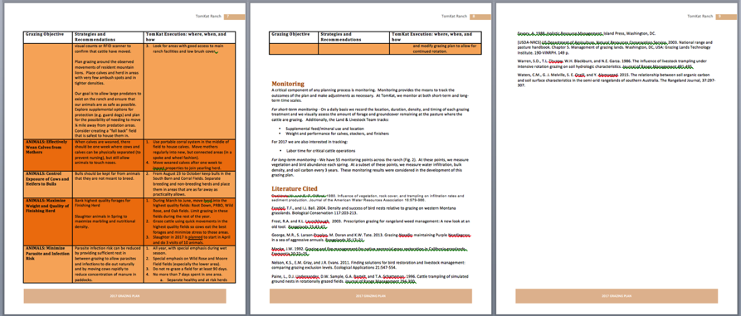
Holistic Planning to Capture All of Grazing’s Benefits

Slide 6
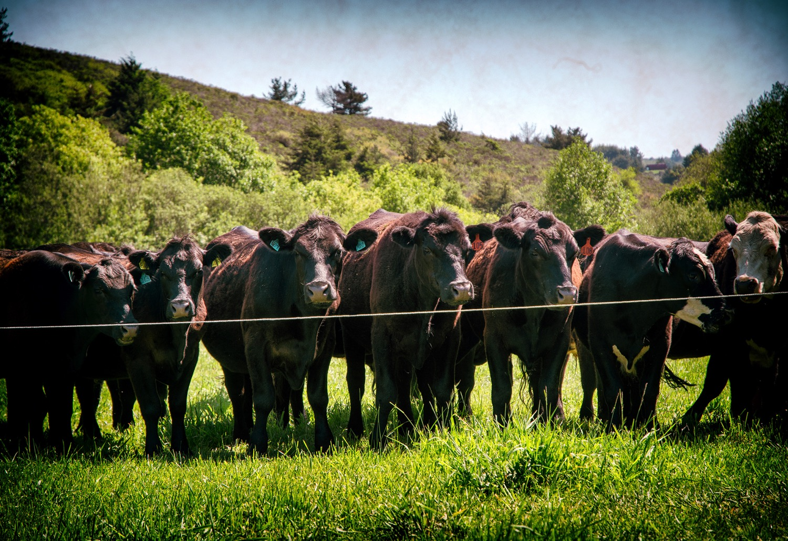
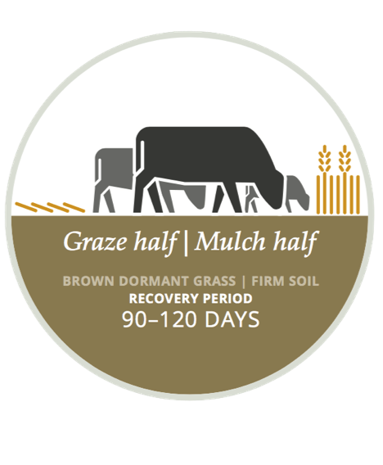
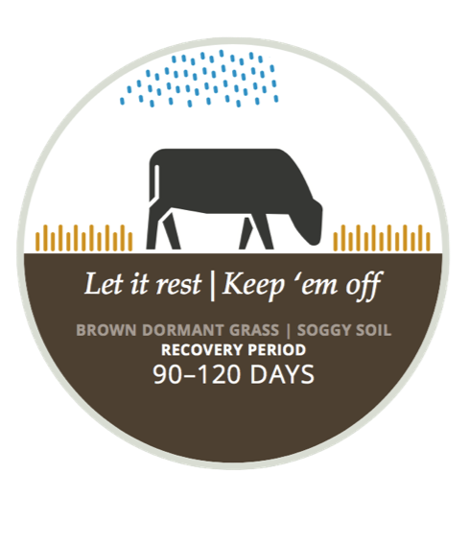
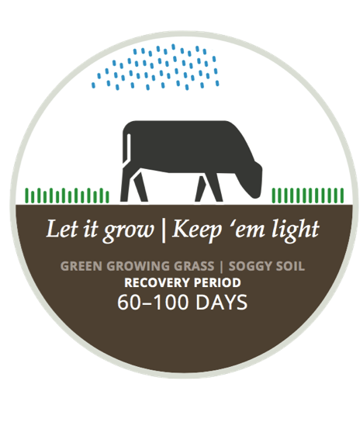
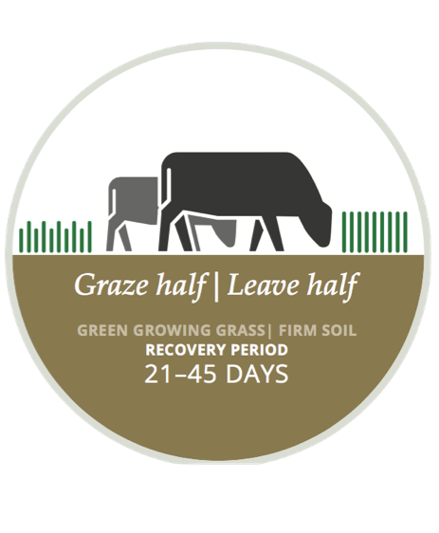
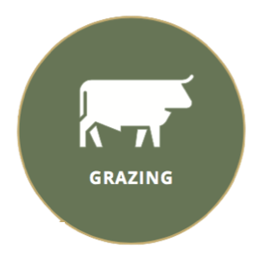
Managing to Increase Photosynthesis

Slide 7
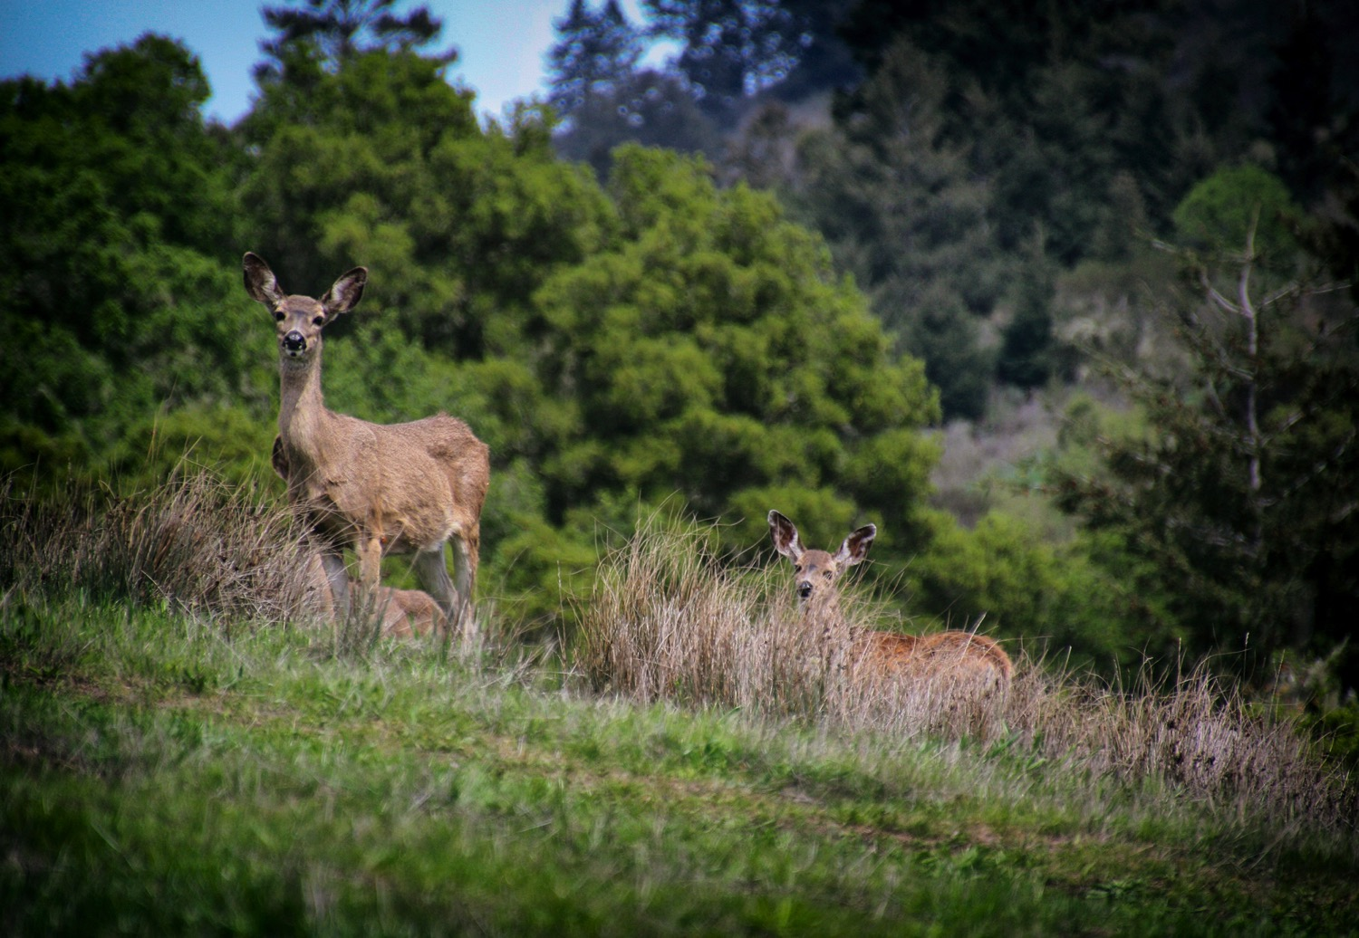
Monitoring to Learn What Works
Notes:
Have noticed an increase in native perennial grasses since the start of their prescriptive grazing.

Slide 8
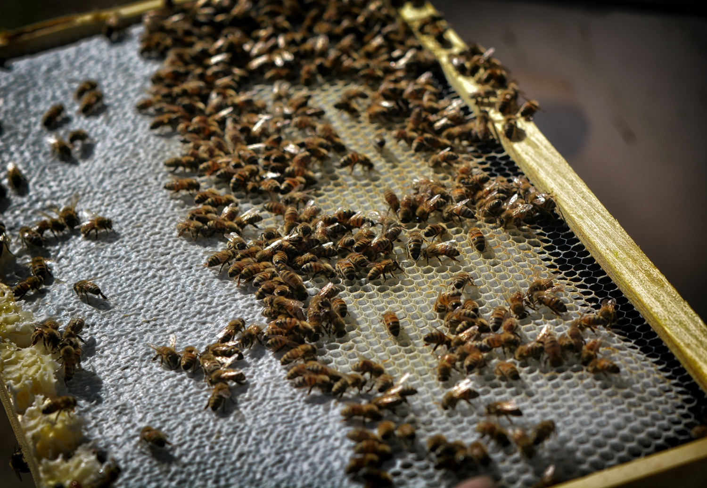
How Can we Scale and Democratize Regenerative Ranching?

Slide 9
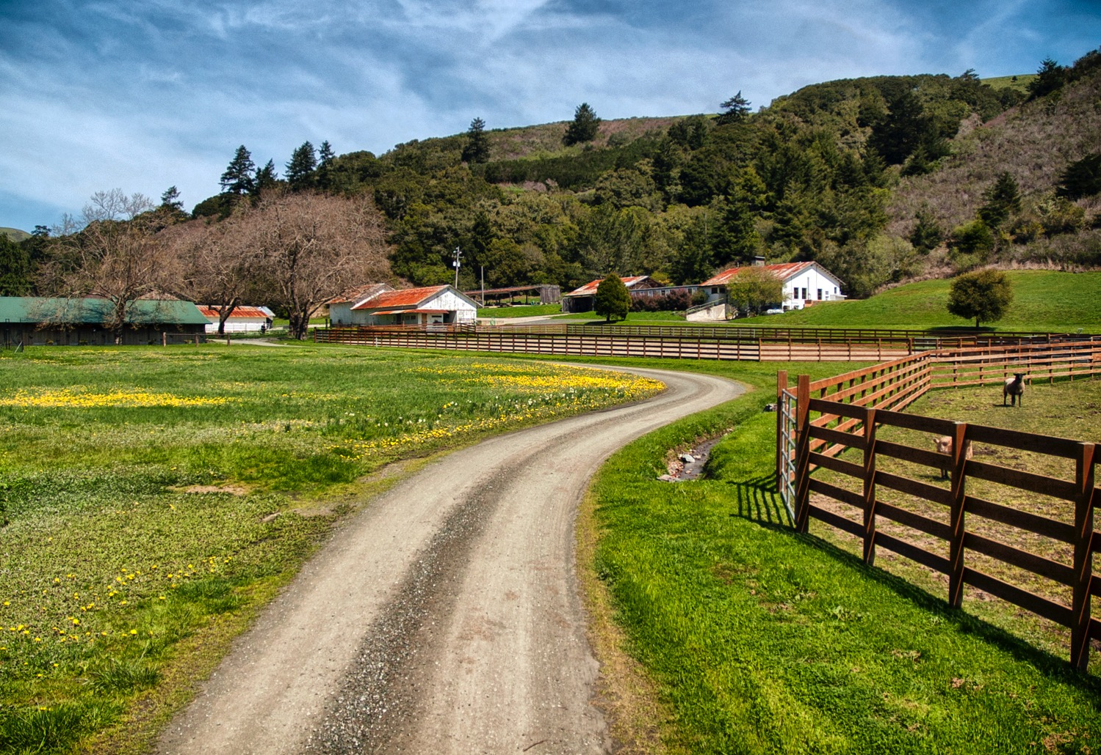
Carbon Farm/Ranch Plans are an Empowering Starting Place
On-ranch carbon is closely correlated to:
Ranch water-holding capacity
Ranch soil health/resiliency
Ranch forage production and bottom line

Slide 10
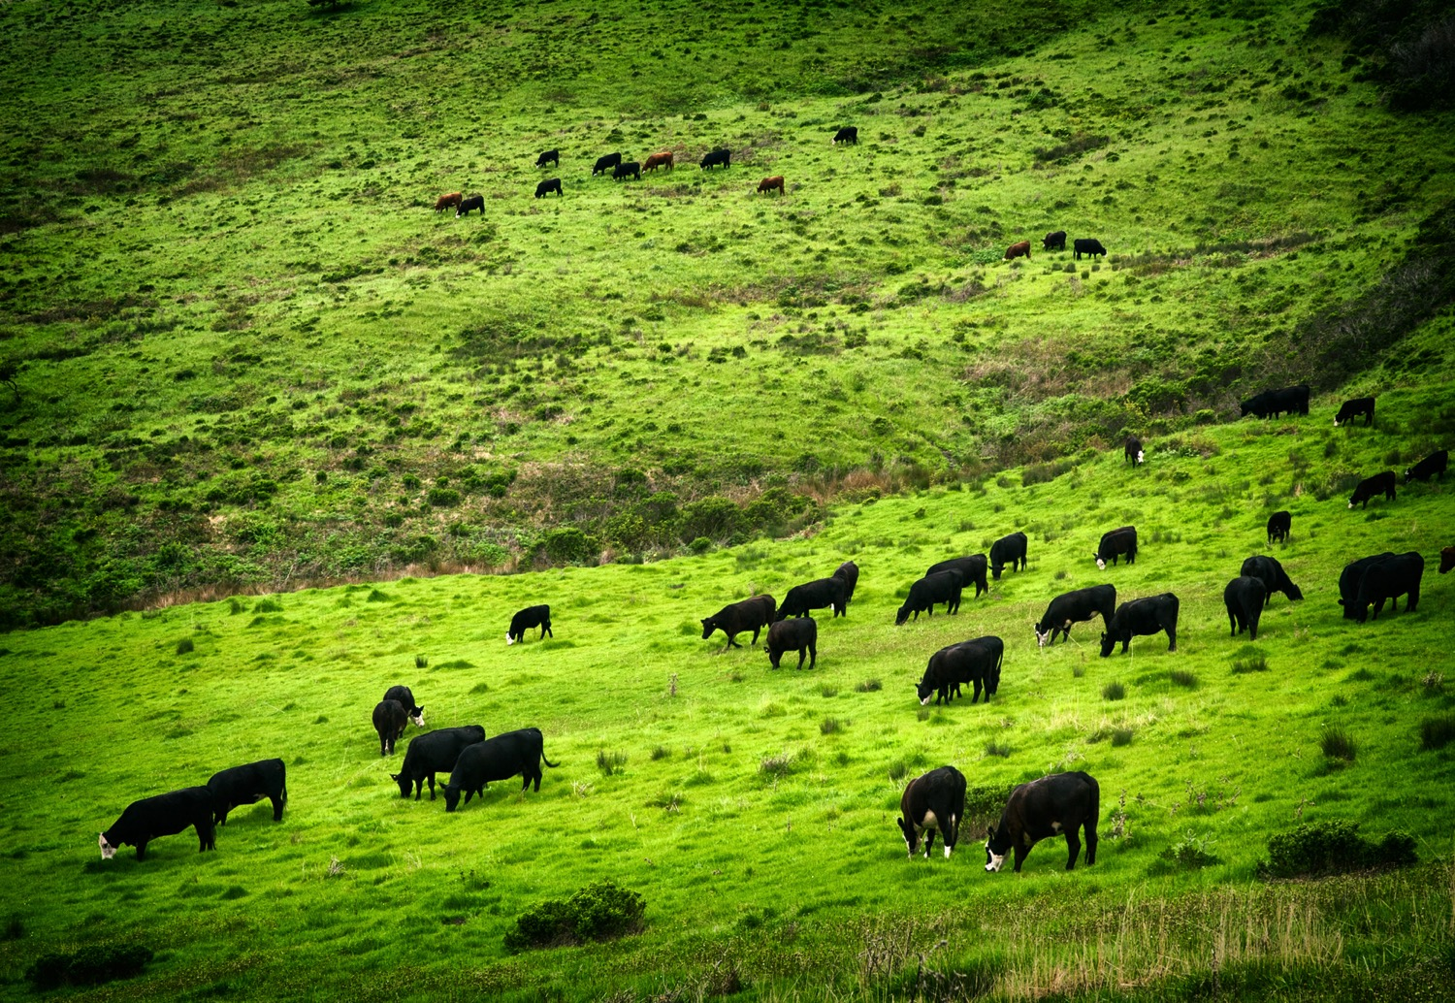
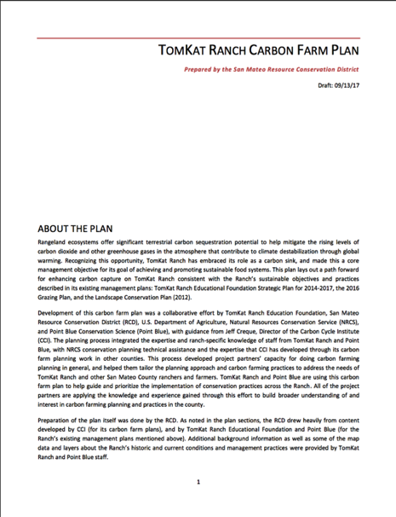
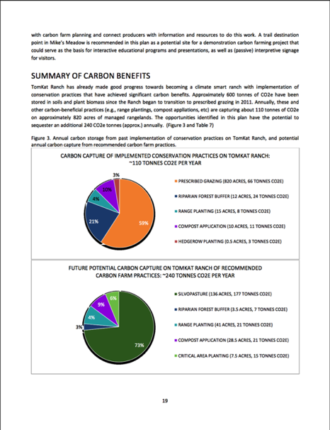
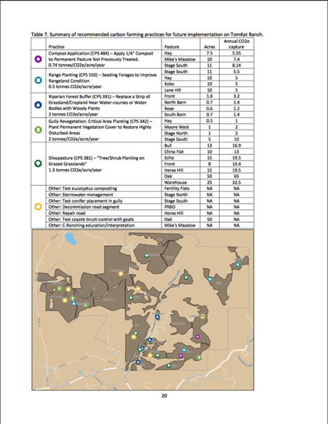
Carbon Plans Give Ranchers More Tools

Slide 11
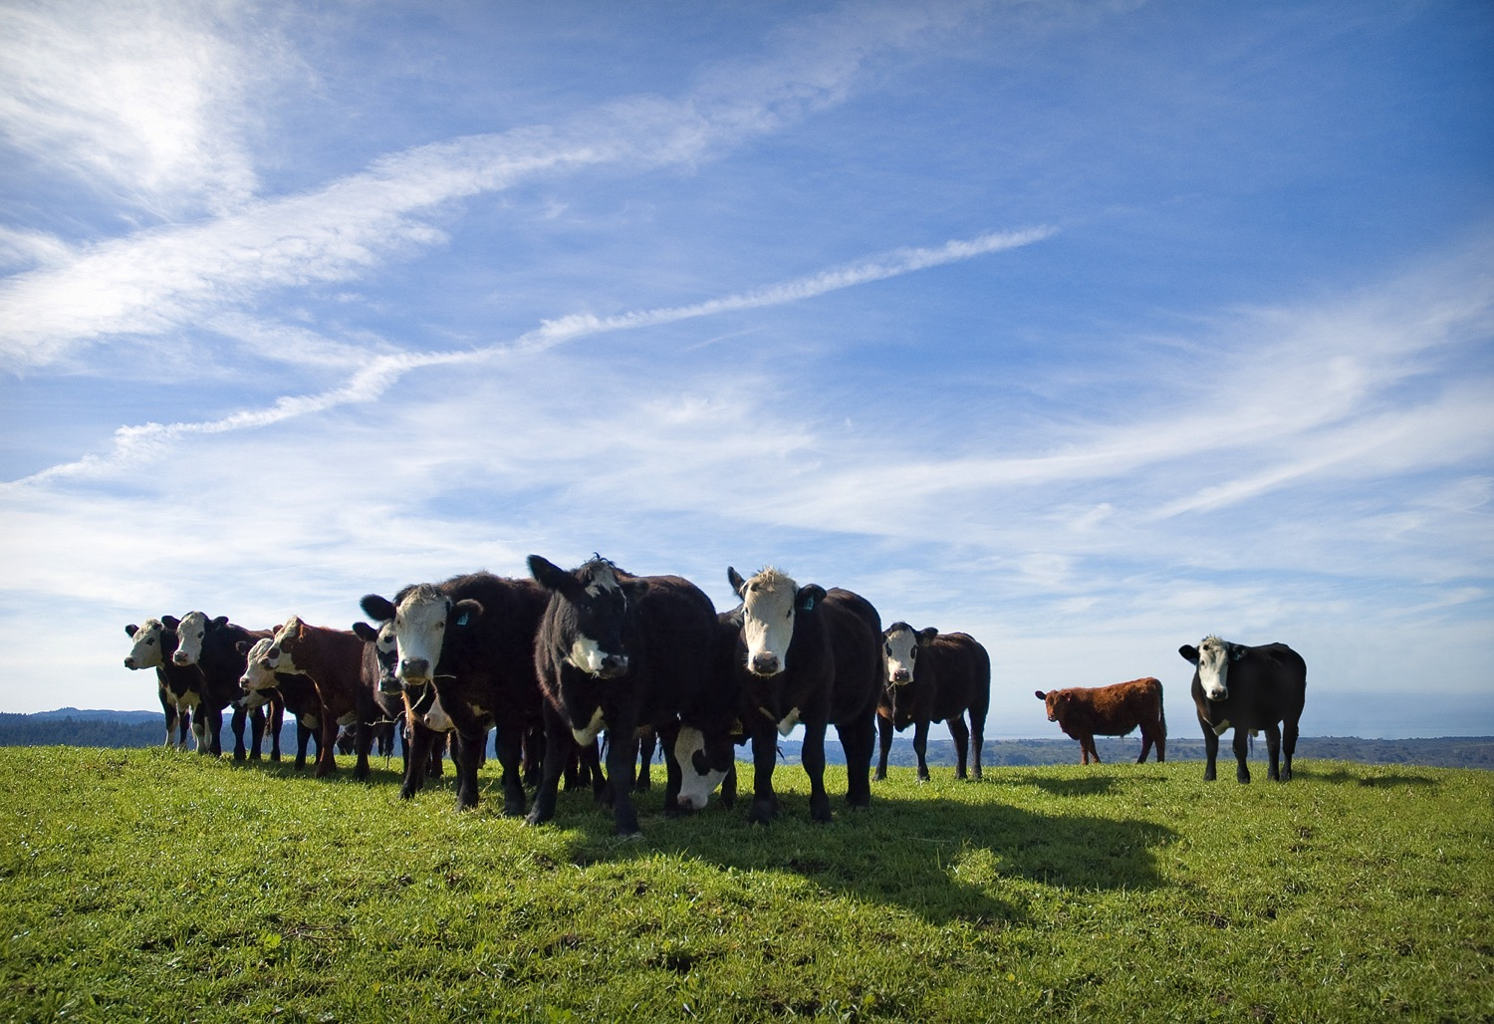
Prescribed Grazing

Slide 12
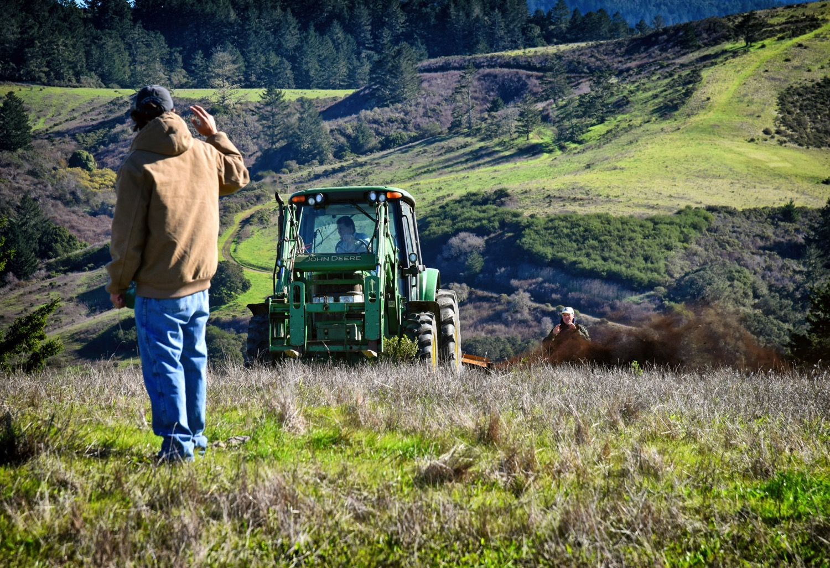
Rangeland Compost Application
Notes:
Statewide Rangeland Compost Application Pilot with NRCS at TomKat Ranch.

Slide 13
Silvopasture Planting
Notes:
Planting of woody vegetation in rangelands- captures carbon, provides habitat, provides shade and shelter for cattle.

Slide 14
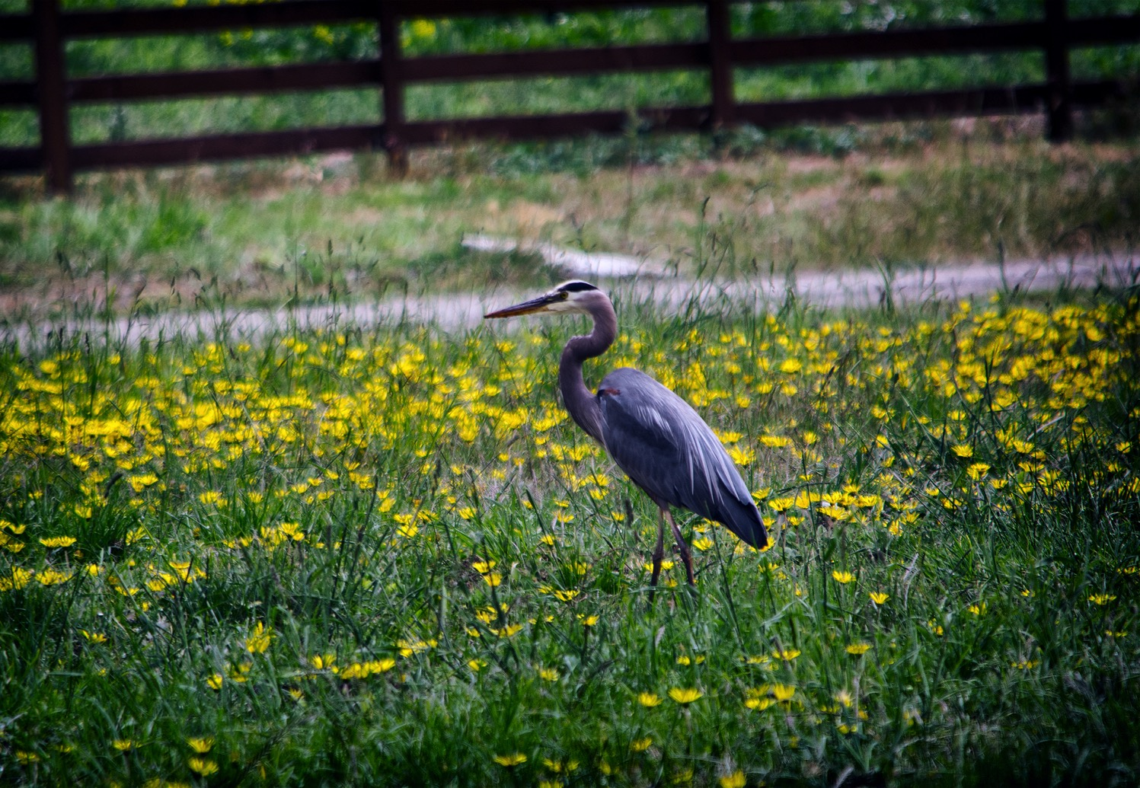
Riparian Area Restoration
Notes:
Riparian Area Restoration

